Slide 1
Overview of Spring Web
Developing modern web applications
with Spring

Slide 2
Topics in this Session
Goals of effective web application architecture
Overview of Spring Web
  Spring Web MVC
  Spring JavaScript
  Spring Web Flow
  Spring Faces
Using Spring in Web Applications

Slide 3
Goals of Effective Web Application Architecture
Be thin
  An effective web architecture is thin
    The web layer plays the role of an adapter responsible for mapping HTTP requests to application functionality
    The application layer encapsulates the business logic and domain complexity
Be clean
  An effective web architecture allows for a separation of concerns
    Designers can focus on markup and style
    Java developers can focus on request processing logic
Good modern web frameworks help meet these goals
Notes:
Business logic encapsulated ->
Testable out of the container
Usable by multiple client types
The web layer plays the role of an mediator or adapter for HTTP-based clients
Handles user requests for application functionality
Issues suitable responses based on results of request handling

Slide 4
Effective Web Application Architecture
Clients
Remote HTTP Interfaces
JVM
Java EE Servlet Container
Web Layer
Local Java Business Interfaces
Application Layer
(Spring)

Slide 5
Topics in this Session
Goals of effective web application architecture
Overview of Spring Web
  Spring Web MVC
  Spring JavaScript
  Spring Web Flow
  Spring Faces
Using Spring in Web Applications

Slide 6
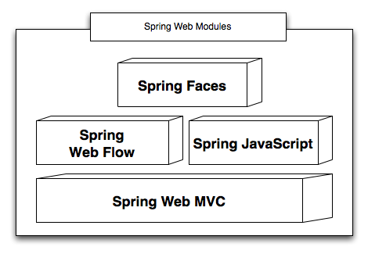
Spring Web: The Big Picture

Slide 7
Spring Web MVC
Spring’s web framework
  Optional component
  Uses Spring for its own configuration
Builds on the Java Servlet API
  A parallel Portlet version is also provided
Comparable to Struts 1.x
  provides a stronger architectural foundation
The core platform for developing web applications with Spring
  All higher-level modules build on it

Slide 8
Spring Web MVC Strengths
Easy to learn
  Few external dependencies
Flexible
  Smart extension points put you in control
  Layered architecture facilitates reuse
Versatile
  Integrates popular view and controller technologies
Uses Spring for its configuration
  testable artifacts
  benefits from dependency injection
Notes:
For re-use:
- reusing application services
- MVC artifacts (controllers, views etc.) are configured in a Spring application context

Slide 9
Spring MVC View Integration
Supported View Technologies
  JSP / JSTL
  Apache Velocity
  Freemarker
  Adobe PDF
  Microsoft Excel
  Jasper Reports
  XML / XSLT

Slide 10
Other Key Features
Data Binding Framework
Validation Support
Internationalization Support
Tag Library
More on Spring Web MVC in the next module!

Slide 11
Spring JavaScript

Slide 12
Spring JavaScript
New module included in Web Flow 2
JavaScript abstraction framework
  builds on Dojo, other implementations possible
Simplifies use for common enterprise scenarios
  avoid proliferation of JavaScript code
Promotes best practices

Slide 13
Spring JavaScript Features
Decorate form input fields
Client-side validation
Ajax events
Fragment rendering
Ajax modal dialogs (pop-up)
Notes:
Start by summarizing the motivation behind the framework and why it exists
Take students through a tour of Spring’s support in each major area
- Spring’s “Core support” is applicable to almost any class of application in nearly any environment
Close with “The Spring Triangle” to capture the key dimensions of developing applications with Spring

Slide 14
More Spring JS Features
Graceful degradation
  Applies progressive enhancement techniques
  Makes your web application more accessible
CSS framework
Performance optimizations
  Our reference applications receive a “A” Yahoo UI Performance Grade
  Custom Dojo Build
    Reduces overall amount of JavaScript transferred to client
  ResourceServlet
    Serves up cached, compressed JavaScript and CSS resources
Ajax error handling

Slide 15
See Spring JS In Action
SpringSource bundle repository application
  http://www.springsource.com/repository
Built on Spring MVC and Spring JavaScript

Slide 16
Spring Web Flow

Slide 17
Spring Web Flow
Plugs into Spring Web MVC as a Controller technology for implementing stateful “flows”
  “A flow encapsulates a reusable sequence of steps that can execute in different contexts”
Raises the abstraction level by providing a dedicated flow definition language (DSL)

Slide 18
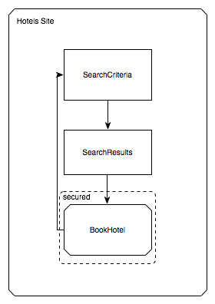
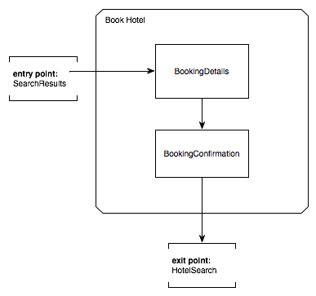
Web Flow Sweet Spot

Slide 19
Example Flow Definition
<flow>
<view-state id=“step1”>
<transition on=“eventA” to=“step2”/>
</view-state>
<view-state id=“step2”>
<transition on=“eventB” to=“done”/>
</view-state>
<end-state id=“done”/>
</flow>

Slide 20
Flow Design
Flows model stateful operations that take a series of requests to complete
  BookHotel
  FlightCheckIn
  EditAccount
  GetInsuranceQuote
  ApplyForLoan
  RegisterNewUser
Can be used for simple “single-request” operations, but not its focus or “sweet spot”

Slide 21
Flows as Web Resources
Flows are addressable web resources
  Address them to begin new operations
Examples
  http://localhost/accounts/register
    Begins a new account registration operation
  http://localhost/flights/checkin
    Begins a new flight check-in operation

Slide 22
Flow Executions are Isolated
Flows execute in isolation from other users
  Provide a local context for operations currently “in progress” but not yet completed
The execution context for each operation is session-specific
  http://localhost/flights/checkin?execution=e1s1
Session-specific flow execution key

Slide 23
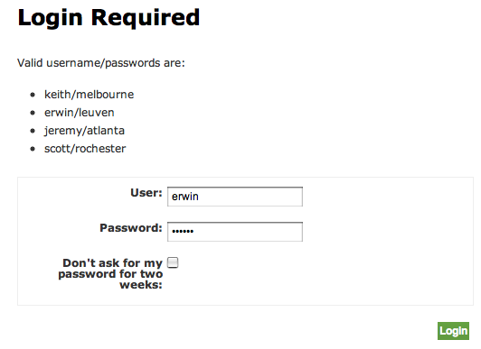
Spring Security Integration
<flow>
<secured attributes="ROLE_USER" />
</flow>
Can also secure states and transitions
Can refer to user Principal using EL
  Use the currentUser implicit variable
  Resolvable within flow and view templates

Slide 24
Flow-Managed Persistence
<flow>
<persistence-context/>
</flow>
Scopes a persistence context with this flow
Automatically used by your data access objects
Support for committing changes made by the flow upon completion
  <end-state id="bookingConfirmed" commit="true" />

Slide 25
Spring Faces

Slide 26
Spring Faces
Combines the JSF UI component model with Web Flow navigation/state management
  All in a native Spring MVC environment
Spring Faces also includes a lightweight JSF component library
  Designed for the 80%
    Includes Ajax support, client-side form validation
  Built on a new Spring JavaScript
    Integrates Dojo as the primary UI toolkit
    Applies progressive enhancement techniques

Slide 27
Spring Faces Benefits
Enhanced page navigation rules
Better exception handling policies
Easier client and server-side (model) validation
Fine-grained state management
  flow scope, view scope, flash scope
Ajax support with graceful degradation

Slide 28


Spring Travel Reference Application Comparison
Plain JSF
Spring Faces
Number of controller artifacts
4
2
Lines of code
333
95

Slide 29
Spring Faces Observations
Makes JSF easier for the Spring community
Pioneering approach to JSF integration
Compliant with JSF 1.1 and 1.2 specifications
Major component libraries are all usable in a Spring Faces environment
  JBoss Rich Faces, Apache Trinidad, IceSoft IceFaces

Slide 30
Topics in this Session
Goals of effective web application architecture
Overview of Spring Web
  Spring Web MVC
  Spring JavaScript
  Spring Web Flow
  Spring Faces
Using Spring in Web Applications

Slide 31
Spring Application Context Lifecycle in Webapps
Spring can be initialized within a webapp
  start up business services, repositories, etc.
Uses a standard servlet listener
  initialization occurs before any servlets execute
  application ready for user requests

Slide 32
Configuration in web.xml
Just add a Spring-provided servlet listener
<context-param>
<param-name>contextConfigLocation</param-name>
<param-value>
/WEB-INF/merchant-reporting-webapp-config.xml
</param-value>
</context-param>
<listener>
<listener-class>
org.springframework.web.context.ContextLoaderListener
</listener-class>
</listener>
The application context’s configuration file(s)
Loads the ApplicationContext into the ServletContext
before any Servlets are initialized
Notes:
<servlet>
<servlet-name>phonebook</servlet-name>
<servlet-class>org.springframework.web.servlet.DispatcherServlet</servlet-class>
<init-param>
<param-name>contextConfigLocation</param-name>
<param-value>
/WEB-INF/phonebook-servlet-config.xml
/WEB-INF/phonebook-webflow-config.xml
</param-value>
</init-param>
</servlet>
<servlet-mapping>
<servlet-name>phonebook</servlet-name>
<url-pattern>*.htm</url-pattern>
</servlet-mapping>

Slide 33
Servlet Container After Starting Up
JVM
Servlet Context
Java EE Servlet Container
Application Layer (Spring)
Application layer context bound in ServletContext under
a special name
Now accessible to
any Servlet or other
Web Layer artifact

Slide 34
Access To Spring-Managed Objects
WebApplicationContextUtils
  static helper
  provides access to the Spring Application Context
Built-in framework integration
  Struts
  JSF
Spring Web MVC
  via dependency injection

Slide 35
“Plain” Servlet Access To Spring
public class TopSpendersReportGenerator extends HttpServlet {
private MerchantReportingService reportingService;
@Override
public void init() {
ApplicationContext context = WebApplicationContextUtils.
getRequiredWebApplicationContext(getServletContext());
reportingService = (MerchantReportingService)
context.getBean(“merchantReportingService”);
}
…
}
Looks up ApplicationContext under its
special name in the ServletContext
Saves the reference to the application entry-point for invocation during request handling

Slide 36
Struts Actions Access to Spring
public class TopSpendersReportAction extends ActionSupport {
private MerchantReportingService reportingService;
@Override
public void onInit() {
reportingService = (MerchantReportingService)
getWebApplicationContext().getBean(“merchantReportingService”);
}
…
}
Extend helper class
Use convenient context access support to lookup beans

Slide 37
Spring Web MVC Controllers
@Controller
public class TopSpendersReportController {
private MerchantReportingService reportingService;
@Autowired
public TopSpendersReportController(MerchantReportingService service) {
this.reportingService = service;
}
…
}
Dependency is automatically injected by type

Slide 38
JavaServer Faces Access To Spring
JSF-centric integration
  Spring plugs in as as a JSF managed bean provider
  configure a VariableResolver in faces-config.xml
  replace all managed beans in faces-config.xml
Spring-centric integration
  JSF managed beans typically declared in flow definition in one of several scopes

Slide 39
Summary
Spring Web has a set of modules for rich web application development
Application-layer, Spring-managed objects can be used in any web application
SpringSource offers 4-day course:
  “Developing Rich Web Applications with Spring”

